Slide 1
Life Cycle of Migration from Oracle DB2 to PostgreSQL
Abhinav Sagar
Premnath Jangam

Slide 2
WHY ?
WHAT ?
HOW ?
WHEN ?

Slide 3
Why to Migrate?
Profit
Profit
Cost of the Product
Product enhancement

Slide 4
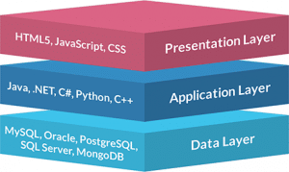
What to Migrate ?

Slide 5
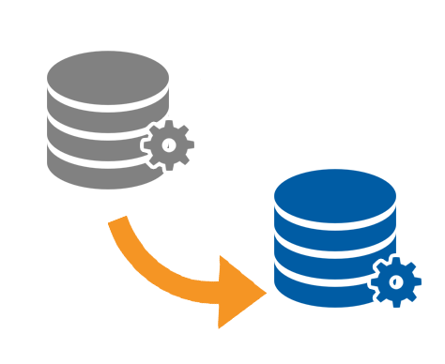
How to Migrate?
Oracle /DB2
PostgreSQL
Data Conversion/Loading

Slide 6
When to Migrate ?
Enough time to migrate and validate
Less business impact due to downtime.
After data purge retention.

Slide 7
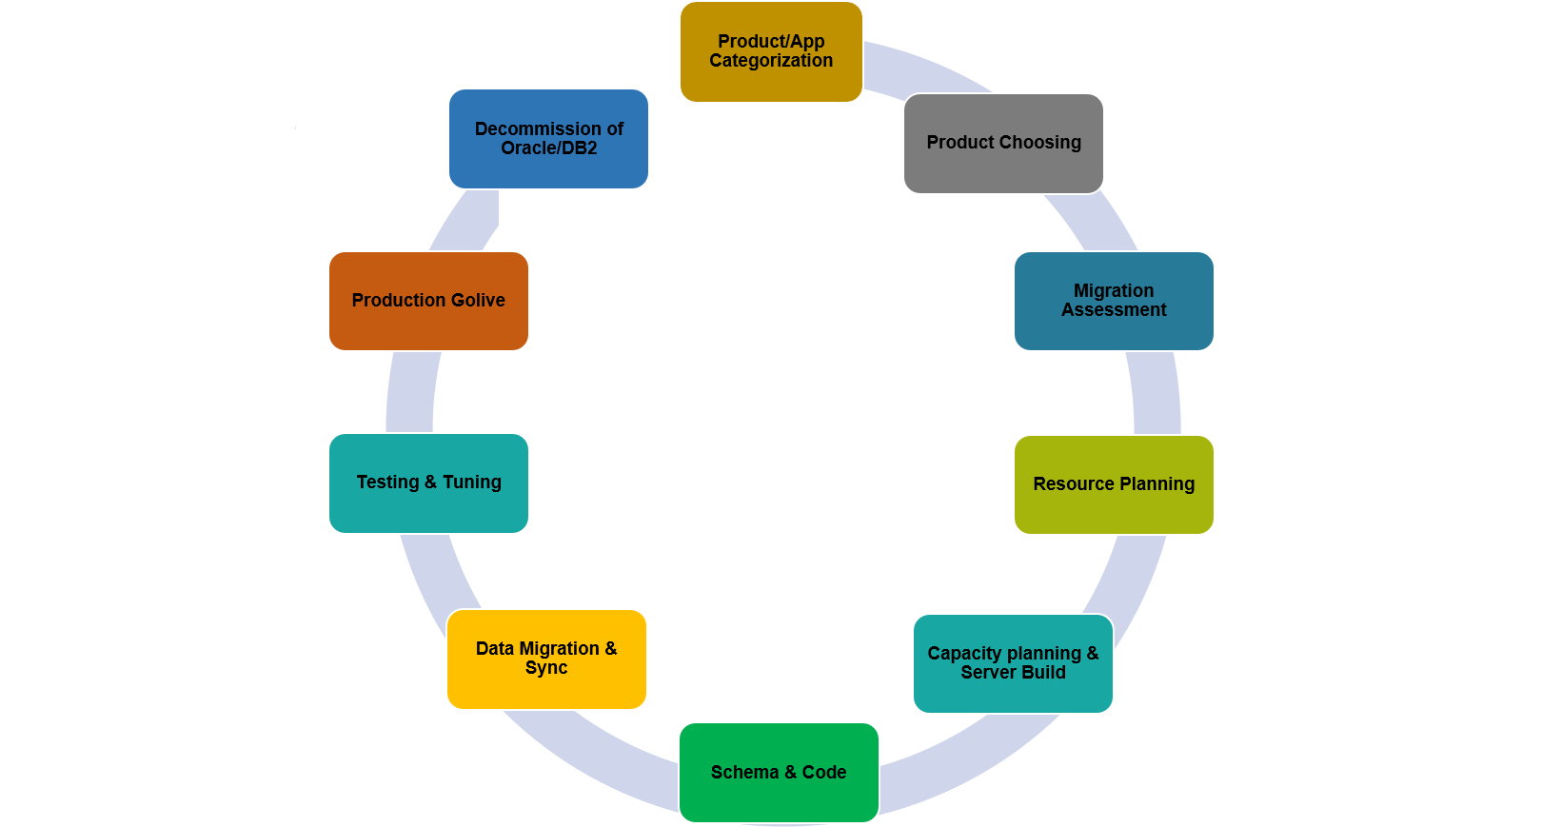
Stages of Life Cycle

Slide 8
Product/Application Categorization
Application Categorization
Choose Product/Application
Complexity of code
Business impact
Cost of product
 | Low | Medium | High
Complexity (C)
Business Impact (B)
Product cost (P)
C B P
Reduce cost in less effort and time with high profitability.
More time and high risk with High profitability

Slide 9
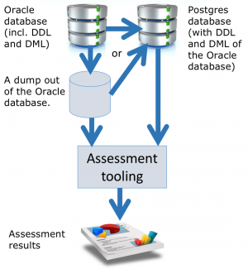
Migration Assessment

Slide 10
Datatypes Compatibility
Data Types | Oracle | DB2 | PostgreSQL
Integer | NUMBER | INTEGER | INTEGER
Decimal | NUMBER | Decimal | Numeric, Decimal
String | CHAR,VARCHAR2,CLOB | CHAR,VARCHAR | CHAR,VARCHAR
Binary | BLOB | BLOB | BYTEA
DATA/TIME | DATE, TIMESTAMP(with/without TIMEZONE) | DATE, TIMESTAMP(without TIMEZONE) | DATE, TIMESTAMP(with/without TIMEZONE)
Boolean | no | no | Yes
XMLTYPE | XMLTYPE | XML | XML
JSON | VARCHAR2,CLOB | BSON | JSONB

Slide 11
Data Volume Compatibility
Capabilities | Oracle | DB2 | PostgreSQL
Max. Database Size | Unlimited | Unlimited | Unlimited
Max. Table Size | 4GB * Block Size | ~2.8TB | 32TB
Max. Row Size | 4TB | N/A | 1.6TB
Max. Field Size | For BLOB: (4GB -1) * DB_BLOCK_SIZE Initialization Parameter | N/A | 1GB
Max. Rows per Table | Unlimited | ~4.2Billion | Unlimited
Max. Columns per Table | 1000 | ~750 | 250 – 1600 Depending on Column types
Max. Indexes per Table | Unlimited | N/A | Unlimited

Slide 12
Programming Compatibility
Program | Oracle | DB2 | PostgreSQL
Triggers | yes | yes | yes
Compound Triggers | yes | no | no
Cursors | yes | yes | yes
Ref Cursors | yes | yes | no
Anonymous Blocks | yes | yes | Yes
Bind | Yes | yes | Yes
Bulk Collect | Yes | yes | No
Parallel query | Yes | yes | Yes
Cast | Yes | Yes | Yes
Pl/Sql supplied packages | Yes | Yes | No
Pragma Autonomous transactions | Yes | Yes | Yes
User defined functions | Yes | Yes | Yes
Stored Procedures | Yes | Yes | Yes (From 11+ version)

Slide 13
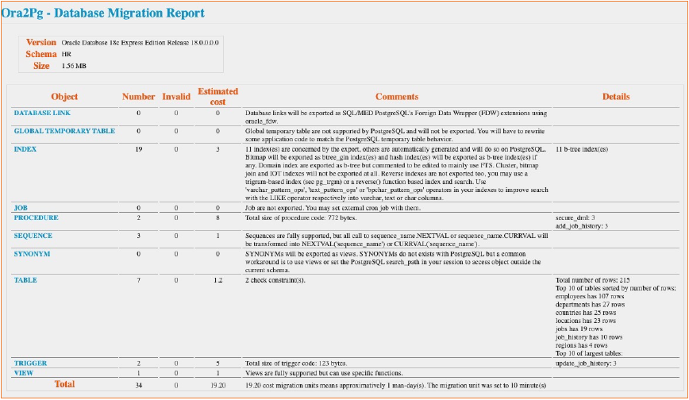
Ora2Pg Tool – Assessment Report

Slide 14
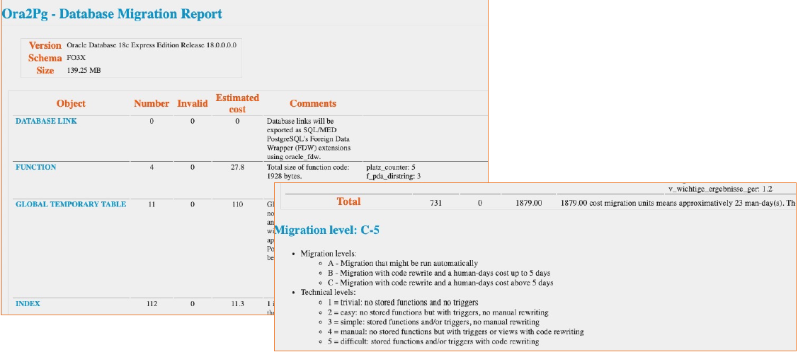
Ora2Pg Tool – Assessment Report (cont..)

Slide 15
Resource Planning
Hardware
OS
Dependent packages
Required Tools
Any Migration Tool (Ora2Pg)
Data Loaders
PgAdmin
Foreign data wrappers(FDW)
Resource Identification
Knowledge Transfer
Test Strategy

Slide 16
Capacity planning & Server build
CPU
RAM
Storage
Network
Backup strategy

Slide 17
Schema & Code conversion
PostgreSQL ANSI standard SQL syntax and datatypes make converting your database schema from other relational databases a fairly straight forward process.
Sometimes migrated code requires manual resolution.
If the code is embedded in application that interfaces with the database has to be modified.

Slide 18
Data migration & Sync
There are different approaches to data migration depending on the size of the data to be migrated.
Example tools :
1. Ora2Pg
2. PG_loaders
3. Slony
4. db_links
5. Foreign data wrappers

Slide 19
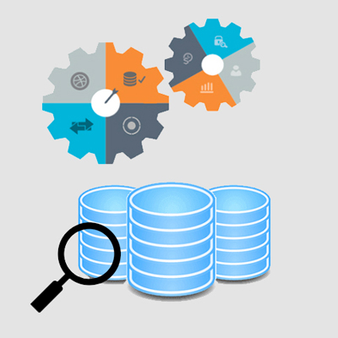
Testing & Tuning
Application connectivity
pg_hba.conf entries
User permissions/Grants
Examples:
PgAdmin - for data validations
Resource utilization by OS & Database
Memory
CPU
I/O
Database
Logs
Locks
Query performance

Slide 20
Testing & Tuning (cont..)
Backups and recoveries with in SLA
HA configuration & DR
Configuring alerting
Reorganization (Maintenance)
Vacuum
Reindex

Slide 21
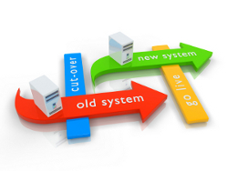
Production Go-Live
Pointing DNS entries
First Steps connections (Read-only)
Reporting
Application dashboards
Transactional part

Slide 22
Decommission of Oracle/DB2 servers
Export code from Oracle/DB2 in to dump files.
Backup DB/OS configuration.
Decommission the Database.

